Slide 1
Cache memories
Adrian Militaru
Computer Organization and Design, 4th Edition

Slide 2

What do programmers wish?
(related to performance)

Slide 3
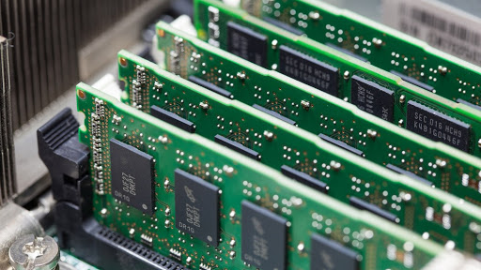
What do programmers wish?
Unlimited amounts of fast memory!

Slide 4
What do programmers wish?
Unlimited amounts of
Fast memory!

Slide 5

A concrete example

Slide 6

Locality principle
Temporal locality

Slide 7

Locality principle
Spatial locality

Slide 8
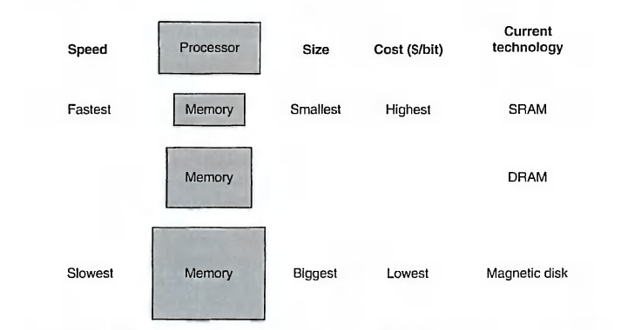
Memory hierarchy

Slide 9
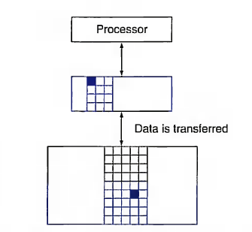
Memory hierarchy

Slide 10
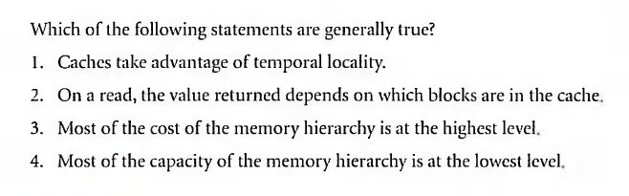
Quiz

Slide 11
Memory hierarchy
Hit rate, hit time
Miss rate, miss penalty

Slide 12
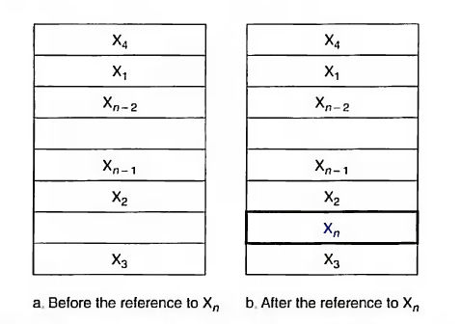
Memory hierarchy
Hit rate, hit time
Miss rate, miss penalty

Slide 13
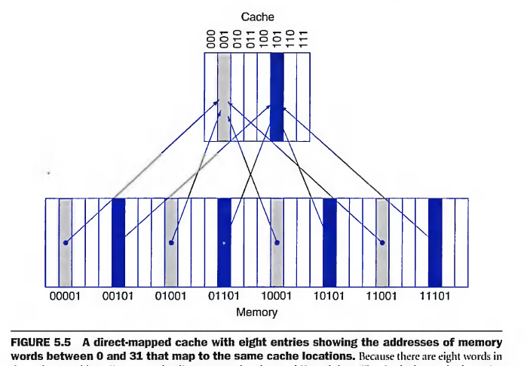
DM (Direct Mapped) Cache
Tag + block => index
Valid bit

Slide 14
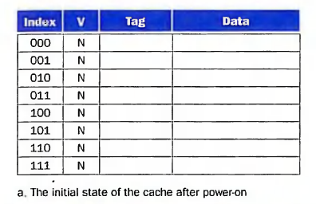
Cache memory example

Slide 15
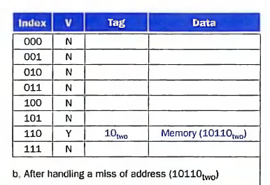
Cache memory example

Slide 16
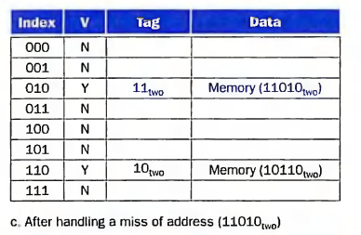
Cache memory example

Slide 17
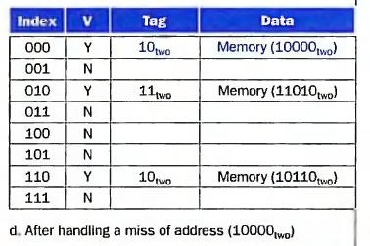
Cache memory example

Slide 18
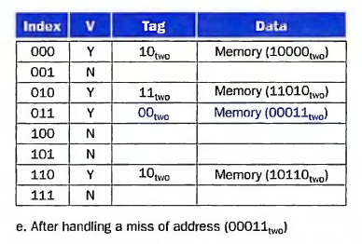
Cache memory example

Slide 19
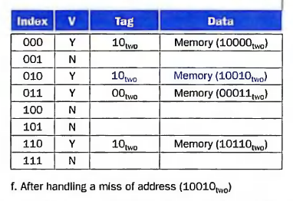
Cache memory example

Slide 20
Important formulas
n
m
Tag size
Memory size = 2^{n} blocks
Cache size = 2^{m} blocks
m bits for index
No. of bits/word = 32
32 - n - block offset - word offset
1 B = 8 b ( 1 byte = 8 biți)

Slide 21
Important formulas
n
m
Tag size
Word addressed vs. byte addressed
TAG | INDEX | BLOCK OFFSET | WORD OFFSET (only for byte addressed)
n-m | m | log₂(no. of words / block) | log₂(no.of bytes / word)
Memory size = 2^{n} blocks
Cache size = 2^{m} blocks
m bits for index
No. of bits/word = 32
32 - n - block offset - word offset
1 B = 8 b ( 1 byte = 8 biți)

Slide 22
Problem no. 1
How many total bits are required for a D.M. cache with 64 KB of data and 4-word blocks, assuming a 32-bit address? We consider a word has 32 bits and the memory is byte addressable.
Transform: data from kilobytes (kB) to bytes (B)
Compute: no. of words, no. of blocks, offsets (word offset, block offset), no. of bits for tag
Multiply data for tag and valid and add it with data

Slide 23
Problem no. 2
How many total bytes are required for a D.M. cache with 32 KB of data and 8-word blocks, assuming a 32-bit address? We consider a word has 32 bits and the memory is word addressable.

Slide 24
Homework
How many total bytes are required for a D.M. cache with 32 KB of data and 8 words/block, assuming a 32-bit address? We consider a word has 32 bits and the memory is byte addressable.
Transform: data from kilobytes (kB) to bytes (B)
Compute: no. of words, no. of blocks, offsets (word offset, block offset), no. of bits for tag
Multiply data for tag and valid and add it with data

Slide 25

Thanks!

